Slide 1
First-Order Logic with Equality

Slide 2
First-Order Logic
"First-Order Logic (FOL) is a formal system used in mathematics, philosophy, and computer science to express relationships between objects and quantify over them."
Significance of equality in logic
"Equality is a fundamental concept in FOL that allows us to express the equivalence or identity between objects."

Slide 3
Importance of Equality
Equality provides a precise way to express relationships between objects, ensuring clarity in logical statements.
By incorporating equality, we enhance the precision and accuracy of our logical representations

Slide 4
Equality Axioms

Slide 5
Reflexivity
Reflexivity ensures that every object is equal to itself.
If a is a number, then. a = a

Slide 6
Symmetry
Symmetry asserts that if A is equal to B, then B is equal to A.
if a = b, then b = a
(a=b) →(b=a)

Slide 7
Transitivity
Transitivity ensures that if A is equal to B and B is equal to C, then A is equal to C
(A = B) AND (B = C) →( A = C)

Slide 8
Substitution for function
If function “f” is of arity N
(x1=y1,x2=y2…..xn=yn)→f(x1,x2…xn)=f(y1,y2,…yn)
Substitution for predicate
If Predicate ‘P’
(x1=y1,x2=y2…..xn=yn)→P(x1,x2…xn) ==P(y1,y2,…yn)

Slide 9
Clause form
Convert the axioms into clause form
Reflexivity x=x
Symmetry ~x=y V y=x
Transivity ~x=y V ~y=z V x=z
Substitution for function:x1 != y1, ….xn!=yn V f(x1…..xn)=f(y1….yn)
Substitution for predicate x1 != y1, V ~P(x1..xn) V P(y1..yn)

Slide 10
Problem
K.B= {N=5, M=N}
Prove M=5

Slide 11
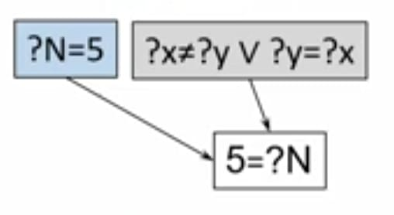
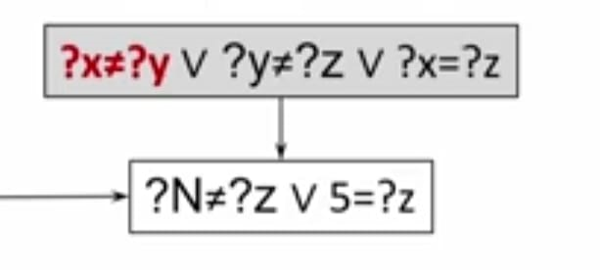
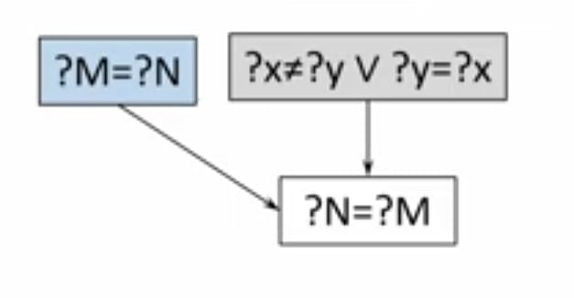
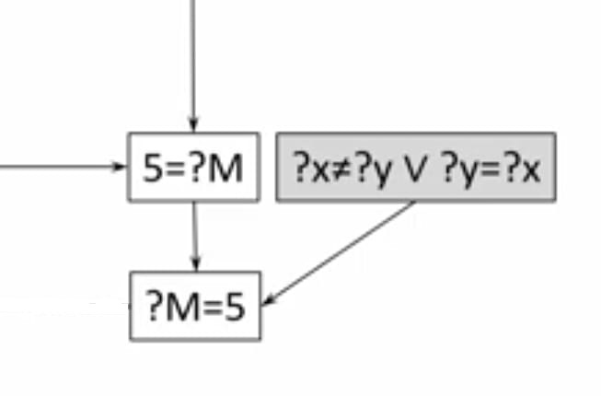

Slide 12
Importance in Knowledge Base
In knowledge bases, equality plays a pivotal role in representing and querying information accurately.
Ensures precise data retrieval and manipulation in databases
Utilized in databases for data integrity and querying.

Slide 13
Question
Despite its power, FOL with equality faces challenges in handling certain complex relationships and scenarios. Your task is to Explore challenges of first-order logic with equality.

